Slide 1
“The internet”
The internet is the global system of interconnected computer network that uses the internet protocol suite to communicate between network and devices.

Slide 2
World internet users

Slide 3
Positive thing
One positive thing about the internet is that you can find whatever you want , whenever.

Slide 4
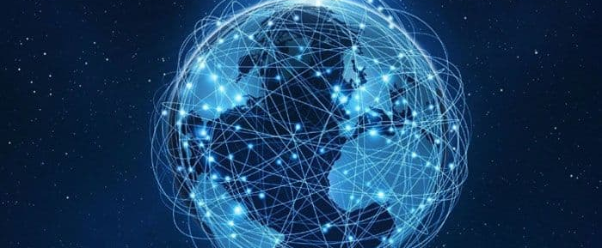
Internet
Internet is used in everywhere , and it is very important.

Slide 5
internet
mobile
technology
comuter

Slide 6
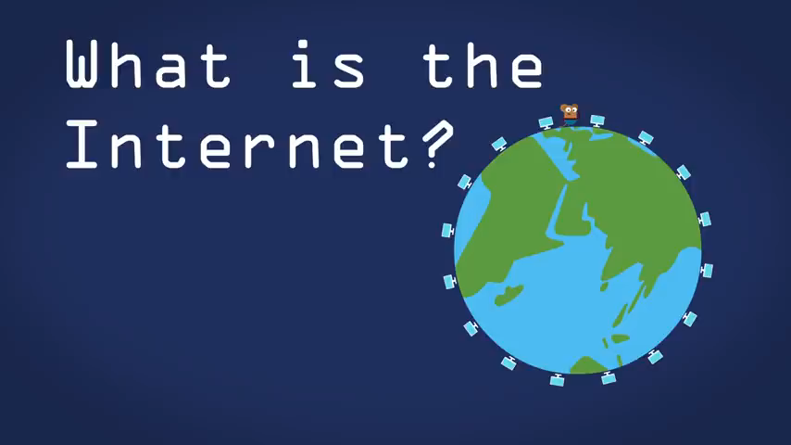

Slide 7
Is the internet like a telephone network?
The internet is not like trlrphone network.

Slide 8
Uses of internet
Communicate
Collaborate with other
Carry out social
Search information

Slide 9
Disadvantages of internet
Addiction
Time wester
Crime
Causes of distraction

Slide 10
Conclusion
Internet was a huge discovery
It is backbone of today’s technology
Will evolve with time

